Slide 1

HLT-Wk3 Assignment on using Tableau Visualization Tool
Analysis was done on a data set for Video Games Sales in various locations in the world.
Key Data Headings are as follows:
Name, Platform, Release_Year, Genre, Publisher, NA_Sales, EU_Sales, JP_Sales, Other_Sale, Global_Sales

Slide 2
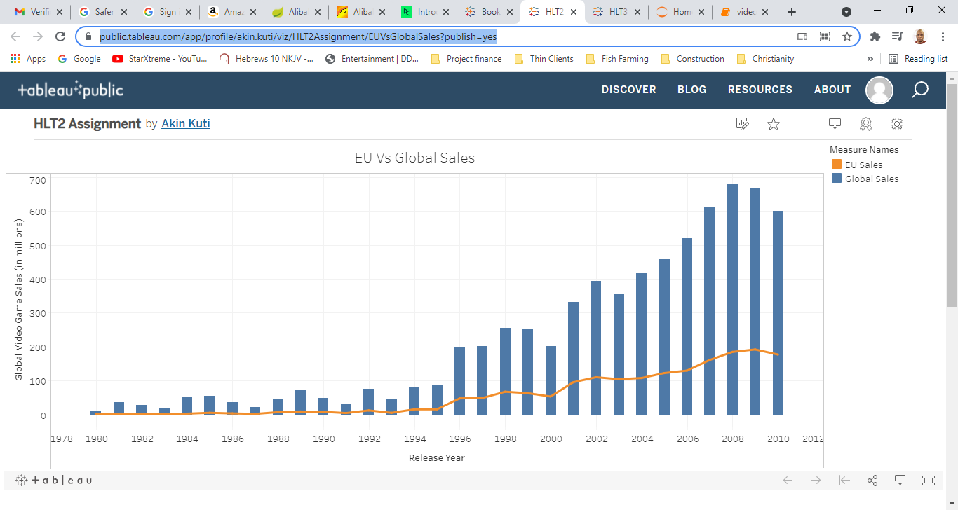
Slide shows the EU_Sales Vs Global_Sales in the listed Years

Slide 3
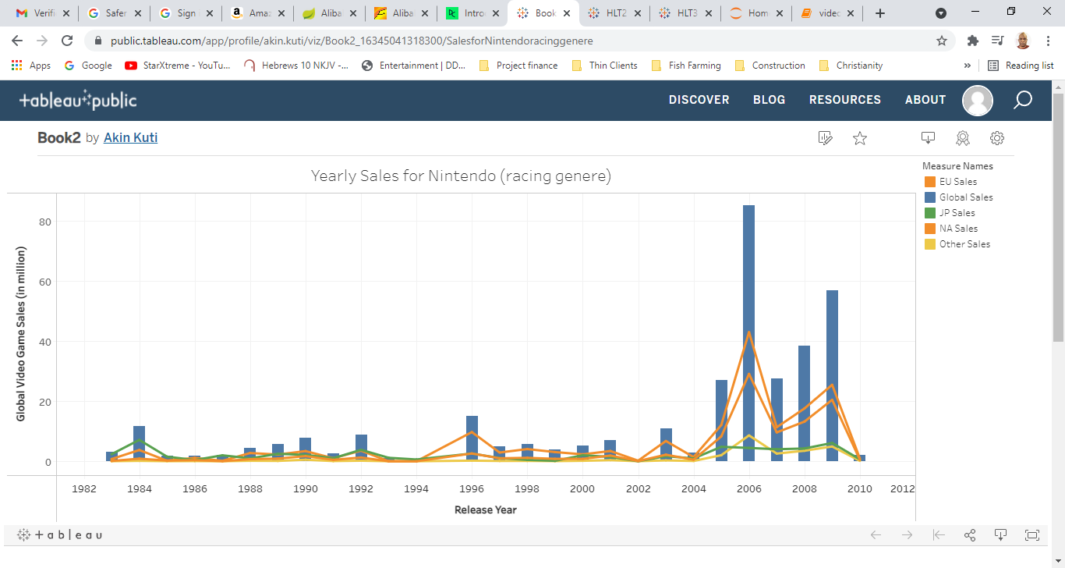
Slide shows the Sales for Nintendo for various regions in the listed Years

Slide 4
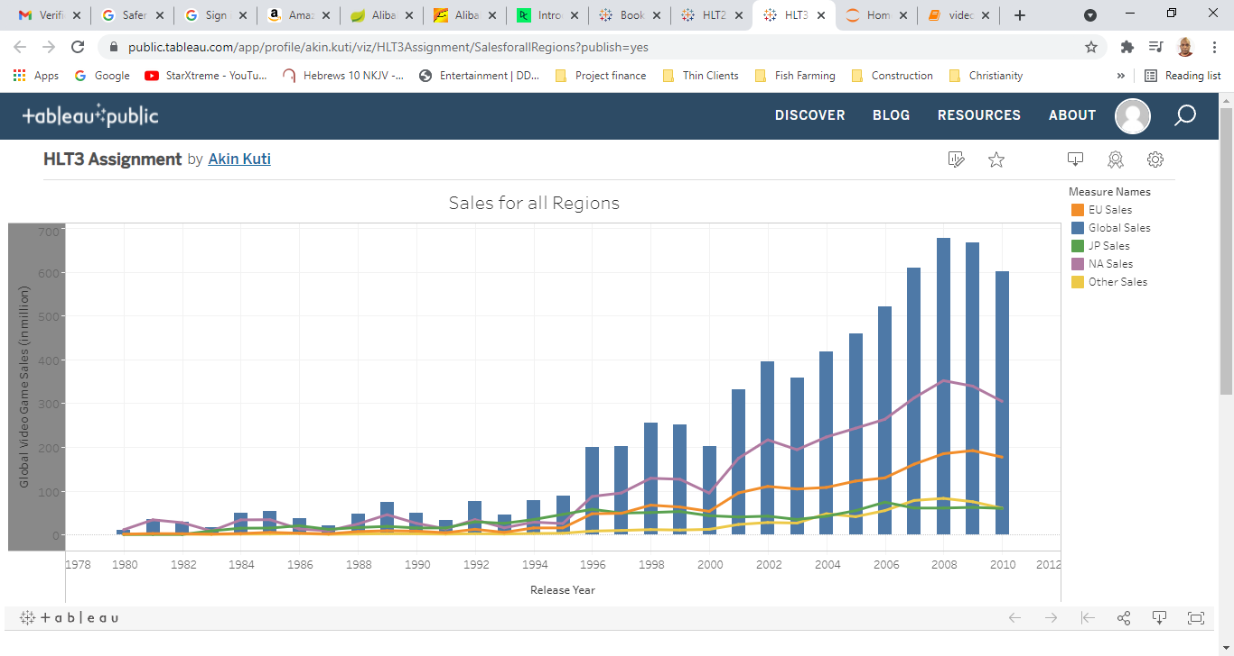
Slide shows the Sales for all Regions in the listed Years

Slide 5
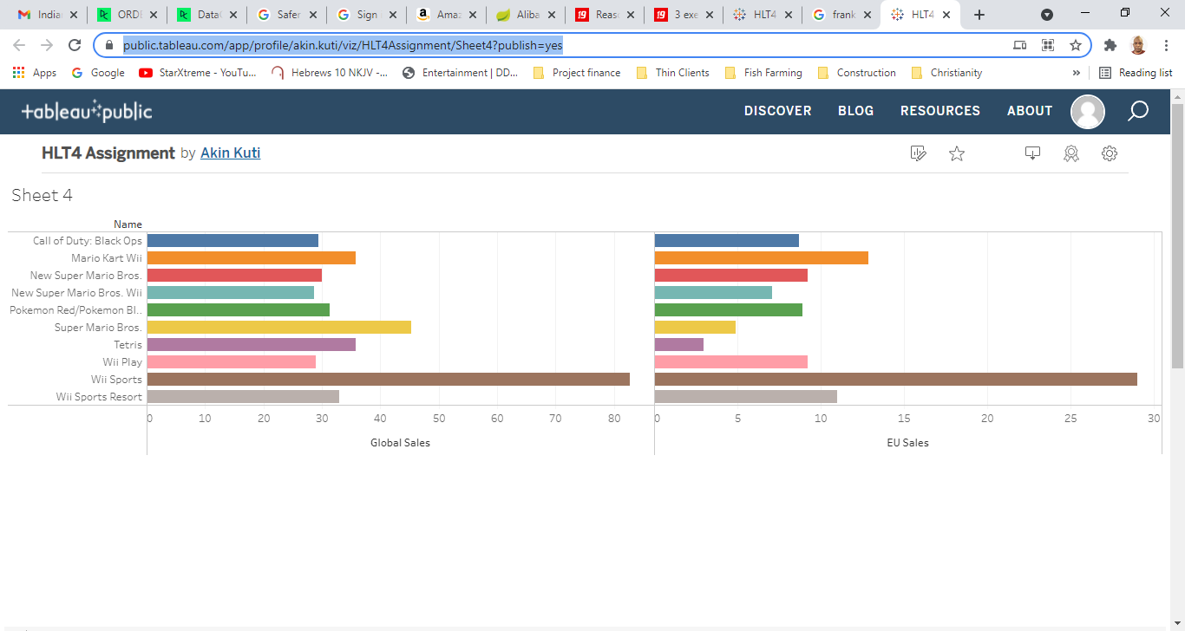
Slide shows Top Ten Games For Global and EU Sales

Slide 6
Links for Visualization on Tableau Public
https://public.tableau.com/app/profile/akin.kuti/viz/HLT1Assignment/EUVsGlobalSales?publish=yes
https://public.tableau.com/app/profile/akin.kuti/viz/HLT4Assignment/SalesforNintendoracinggenere?publish=yes
https://public.tableau.com/app/profile/akin.kuti/viz/HLT2Assignment/EUVsGlobalSales?publish=yes
https://public.tableau.com/app/profile/akin.kuti/viz/HLT4Assignment/Sheet4?publish=yes

